Slide 1

1st REVIEW
An AI-Driven Adaptive Cybersecurity Awareness and Phishing Simulation Platform
Name1:Gopireddy Susmitha | Roll no: 2520030201
Name2: Yerrolla Eekshitha | Roll no: 2520030615
Name3:Kota Sudheer Babu | Roll no:2520030470
Under the Guidance
of
Ms M Usha Rani
Assitant Professor
Department of Computer Science and Engineering
KONERU LAKSHMAIAH EDUCATION FOUNDATION

Slide 2
GROUP NUMBER:1
Name of Candidate | Role
Gopireddy Susmitha | Backend & Phishing Simulation
Yerrolla Eekshitha | Frontend & Dashboard Development
Kota Sudheer Babu | AI/ML & Adaptive Training

Slide 3
ABSTRACT
The proposed platform uses Artificial Intelligence to improve cybersecurity awareness through safe, controlled phishing simulations.
It generates and delivers realistic training scenarios, observes user responses, and adapts future exercises according to individual risk and learning needs.
A dashboard provides awareness scores, phishing-risk indicators, training progress, and recommendations for targeted learning.
The goal is to reduce risky user behavior and build continuous security awareness without exposing real users or systems to malicious attacks

Slide 4
INTRDOUCTION
Phishing is a major social-engineering threat because attackers exploit human decisions rather than only technical vulnerabilities.
Traditional awareness programs often use the same training material for every user and may not measure whether behavior actually improves.
This project combines phishing simulation, user-behavior analysis, AI-based risk assessment, and personalized awareness training.
All simulations are designed for authorized educational use in a controlled environment.

Slide 5
EXISTING SYSTEM
Conventional cybersecurity awareness systems mainly provide static videos, quizzes, posters, and periodic phishing exercises.
Many solutions use fixed scenarios and do not sufficiently personalize training based on a user's previous responses.
Reporting is often limited to basic click or quiz statistics, making it difficult to identify changing risk patterns.
There is a need for a continuous, measurable, and adaptive approach to cybersecurity awareness.

Slide 6
PROBLEM
Users may recognize common phishing examples but still fall for unfamiliar or highly personalized messages.
A one-size-fits-all awareness program cannot address different levels of knowledge and risk.
Organizations need a safe way to evaluate user awareness without sending real malicious content or collecting unnecessary sensitive information.
The challenge is to transform simulation results into personalized training and measurable improvement.

Slide 7
SOLUTION(Contribution)
Develop a controlled phishing-simulation engine that creates safe training scenarios and tracks user interaction.
Use AI/ML to calculate an awareness or risk score from simulation outcomes and training performance.
Adapt the difficulty, scenario type, and learning content based on the user's previous behavior.
Provide dashboards for users and administrators with progress, trends, and recommended training.
Include safeguards such as authorized test accounts, isolated simulation links, logging controls, and no real credential collection.

Slide 8
Objectives
Design an interactive platform for cybersecurity awareness and phishing simulation.
Identify user risk patterns from safe simulation results.
Build an AI-driven mechanism for personalized risk scoring and training recommendations.
Provide adaptive phishing scenarios with varying difficulty and attack characteristics.
Track awareness improvement through dashboards, reports, and repeated assessments.
Maintain privacy and safety by using simulated content in an isolated environment.

Slide 9
Modules
1. User & Admin Management — authentication, roles, profiles, and permissions.
2. Phishing Simulation Engine — safe email/web scenarios, templates, scheduling, and tracking.
3. AI Risk Assessment — feature extraction, risk scoring, classification, and trend analysis.
4. Adaptive Training Module — personalized lessons, quizzes, and difficulty adjustment.
5. Analytics Dashboard — click/report rates, awareness score, progress, and risk trends.
6. Reporting & Monitoring — campaign summaries, recommendations, and exportable reports.

Slide 10
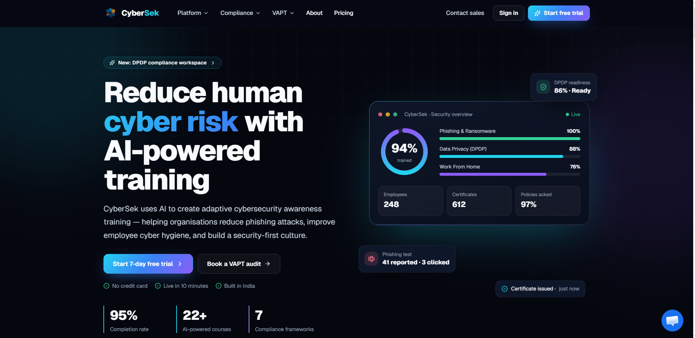
SCREENSHOTS

Slide 11
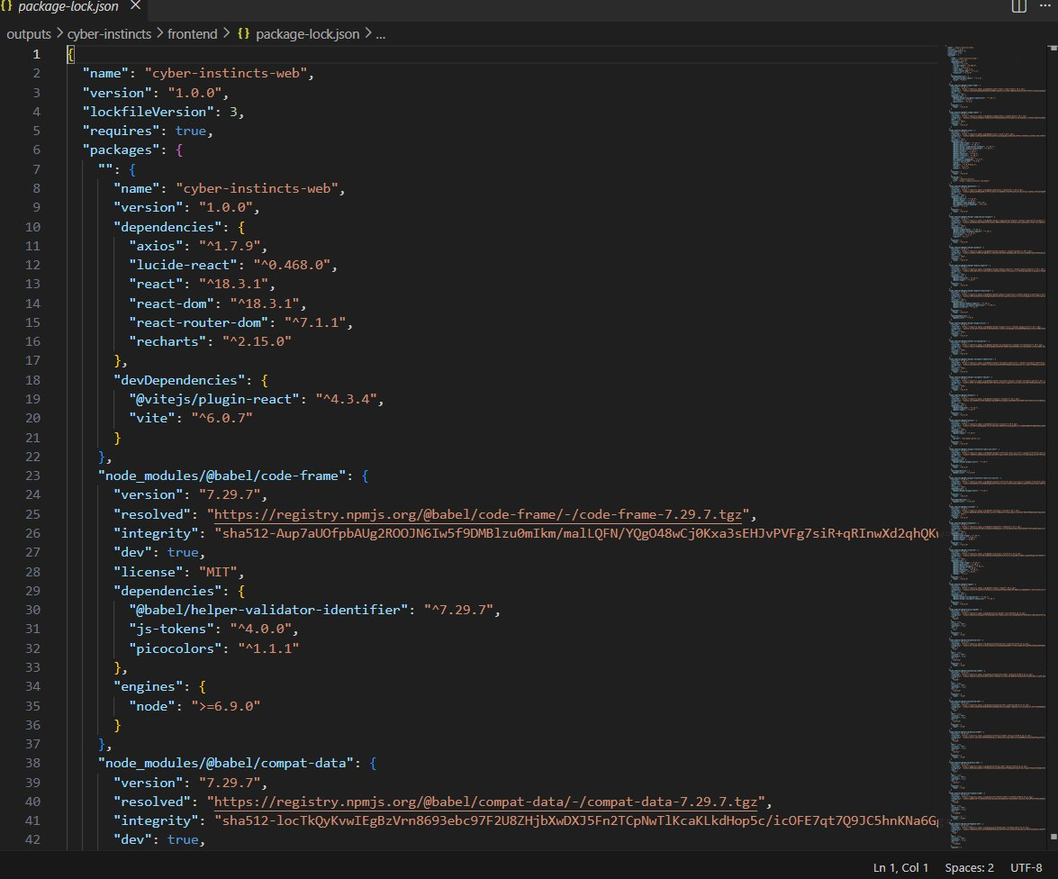
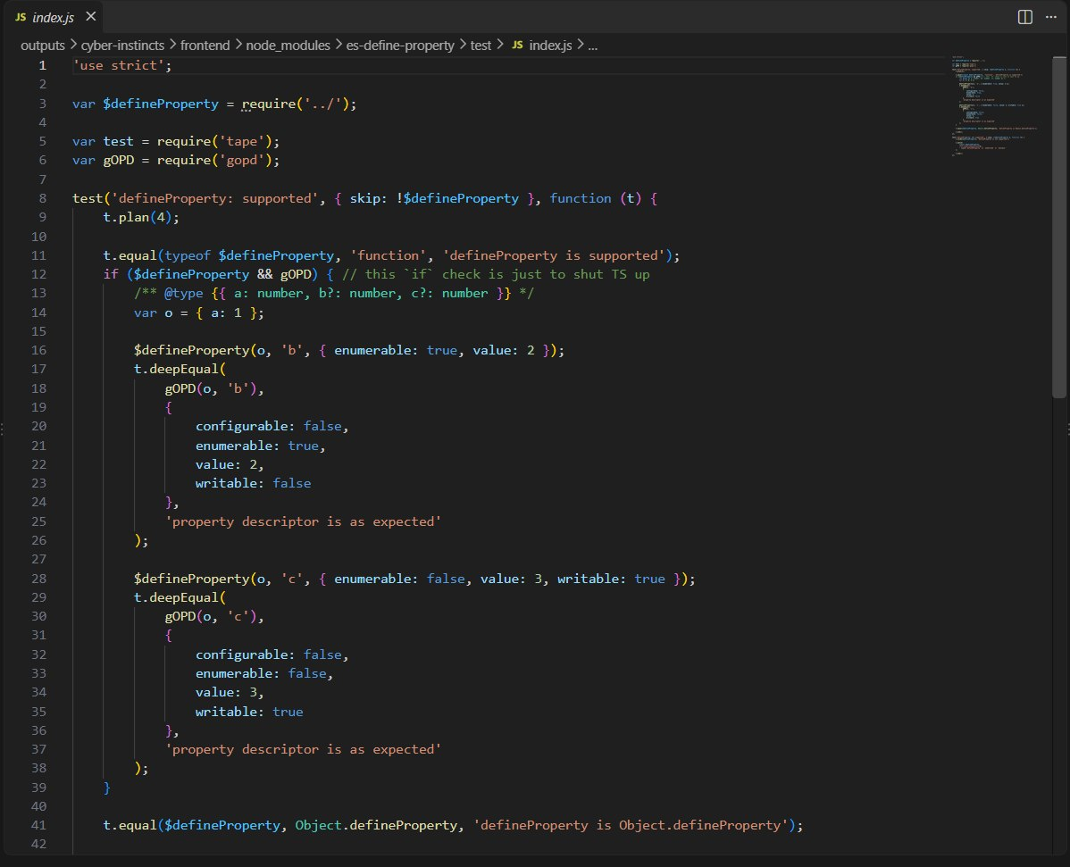
FRONTEND CODE

Slide 12
SOFTWARE REQUIREMENTS
Frontend: HTML, CSS, JavaScript / React.js
Backend: Python with Flask/FastAPI or Node.js with Express
AI/ML: Python, Pandas, NumPy, Scikit-learn; optional NLP model for message classification
Database: MySQL or PostgreSQL
Development Tools: VS Code, Git/GitHub, Postman
Deployment: Localhost or a controlled cloud/server environment
Hardware: Standard laptop/PC; optional cloud VM for testing

Slide 13
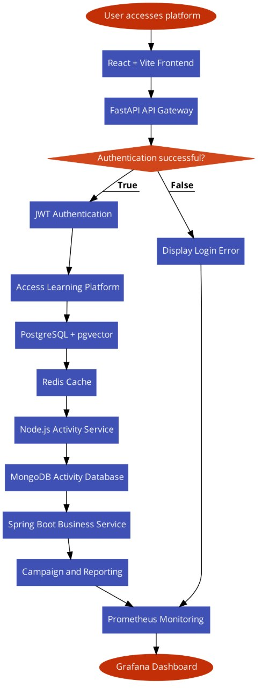
SYSTEM ARCHITECTURE

Slide 14
CONCLUSION AND FUTURE SCOPE
The proposed platform combines phishing simulation, AI-based risk assessment, and adaptive learning into one cybersecurity awareness system.
It can help identify weak awareness areas, personalize training, and measure improvement over time.
Future scope includes advanced NLP for safer scenario generation, reinforcement-learning-based adaptation, multilingual training, and integration with organizational security-awareness workflows.
The system can also be extended with privacy-preserving analytics and richer behavioral trends while keeping simulations isolated and authorized.

Slide 15
THANK YOU

